Slide 1
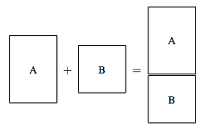

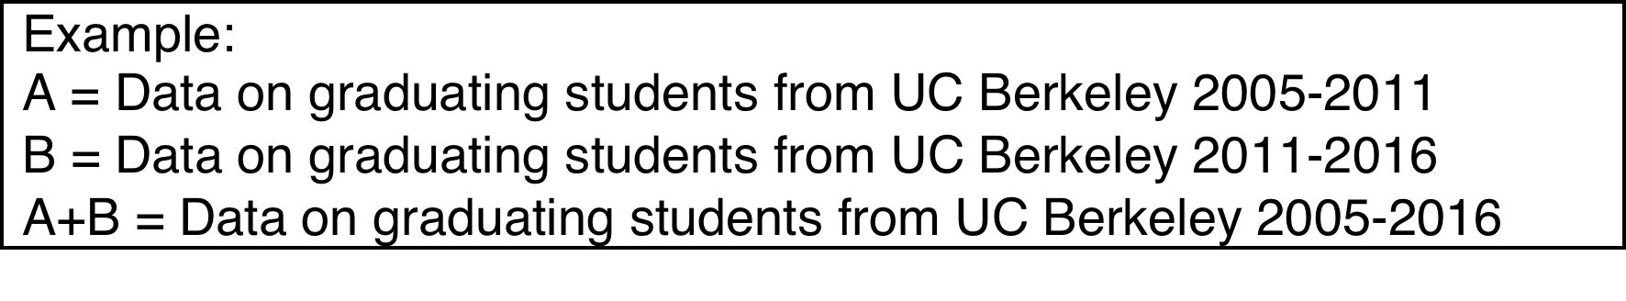
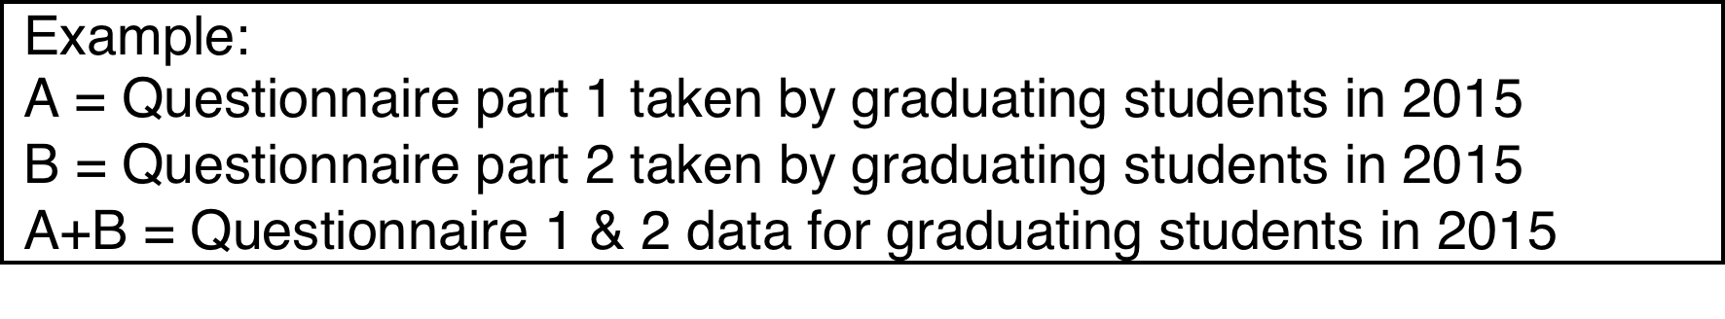
Append
Merge

Slide 2
Append

Slide 3
Merge

Slide 4
Reshape

Slide 5
Macros
Macros are names you can give to various objects in stata including strings, estimation results, or any numerical value you want it to represent.
Global macro – remains in memory for the session
Local macro – exists only within the block of code you run

Slide 6
Macros: Syntax
After you have created a global or a local macro and you want to `call’ it, you need to use a specific syntax for each:
For global: use $ in front of the global macro’s name (e.g. $mymacro)
For local: use ` ‘ to envelope the local macro’s name (e.g. `mymacro’).
Note: The two apostrophes are different.

